Slide 1

Introduction to Machine Learning with H2O
Jo-fai (Joe) Chow
Data Scientist
joe@h2o.ai
Paris Machine Learning Meetup
Murex
21st September, 2016

Slide 2
About Me: Civil Engineer → Data Scientist
2005 - 2015
Water Engineer
Consultant for Utilities
EngD Research
Machine learning + Water Engineering
2015 - Present
Data Scientist
Virgin Media (UK)
Domino Data Lab (US)
H2O.ai (US)
Why? Long story – see bit.ly/joe_h2o_talk2

Slide 3
Agenda
This Talk (30 mins)
About H2O.ai
Demos
Web Interface
R
H2O Use Cases
Why H2O?
Moving Forward
New developments (e.g. Deep Water)
Second Talk (30 mins)
Deep Water
Demos
H2O + mxnet
H2O + TensorFlow
Third Talk (45 mins)
H2O + Spark = Sparkling Water
Demos
H2O + Spark MLlib

Slide 4
About H2O.ai

Slide 5
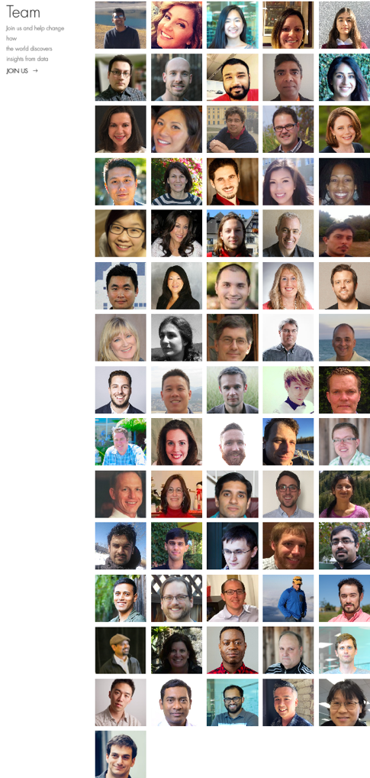
About H2O.ai
H2O.ai, the Company
Team: 80 (71 shown)
Founded in 2012
HQ: Mountain View, California
H2O, the Platform
Open Source (Apache 2.0)
R, Python, Scala, Java and Web Interfaces
Distributed Algorithms that Scale to Big Data
Works with Laptop, Hadoop & Spark
Jakub
(Kuba)
Joe
Notes:
Team is growing rapidly
Based in Mountain View – I am the only guy in UK/Europe
VC: $34M in total

Slide 6
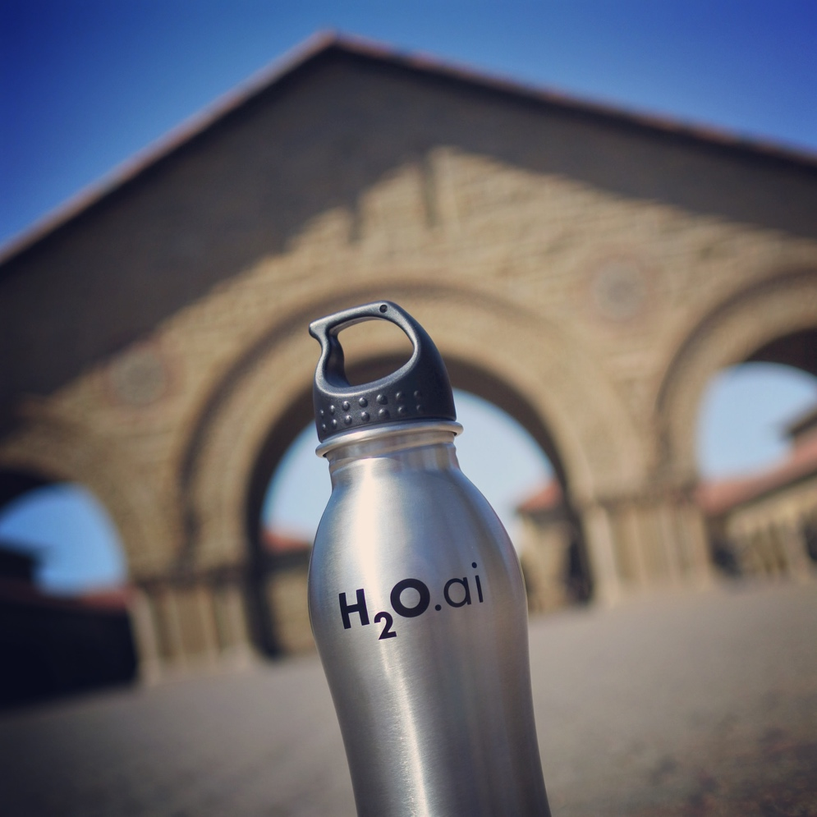
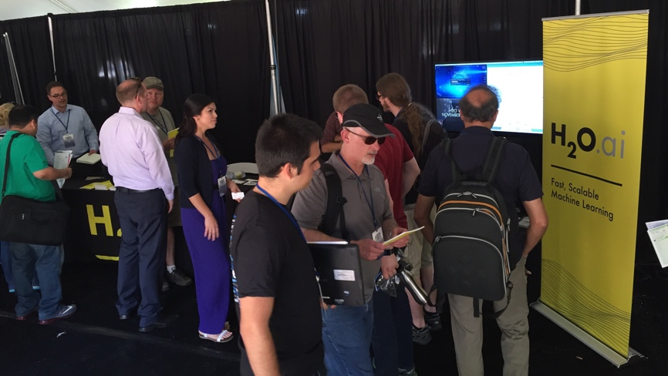
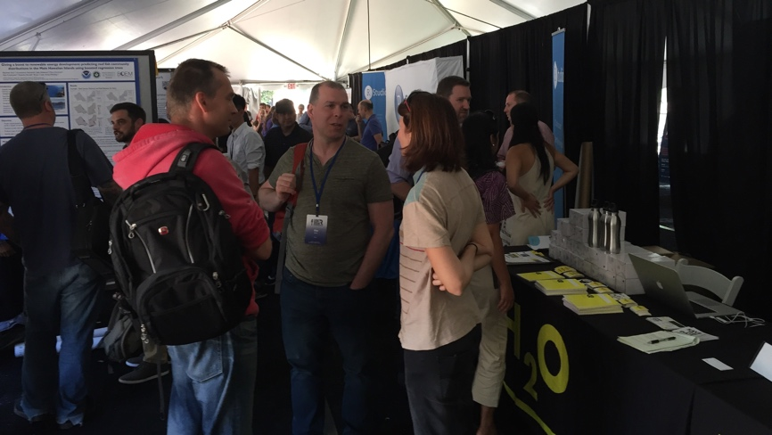
H2O.ai & Stanford University
useR! 2016 Conference at Stanford

Slide 7


Scientific Advisory Council

Slide 8







H2O Platform Overview
Core algorithms written in high performance Java.
Fast, distributed and scalable.
APIs available in R, Python, Scala, REST/JSON and web.
Works with laptop, Hadoop and Spark

Slide 9
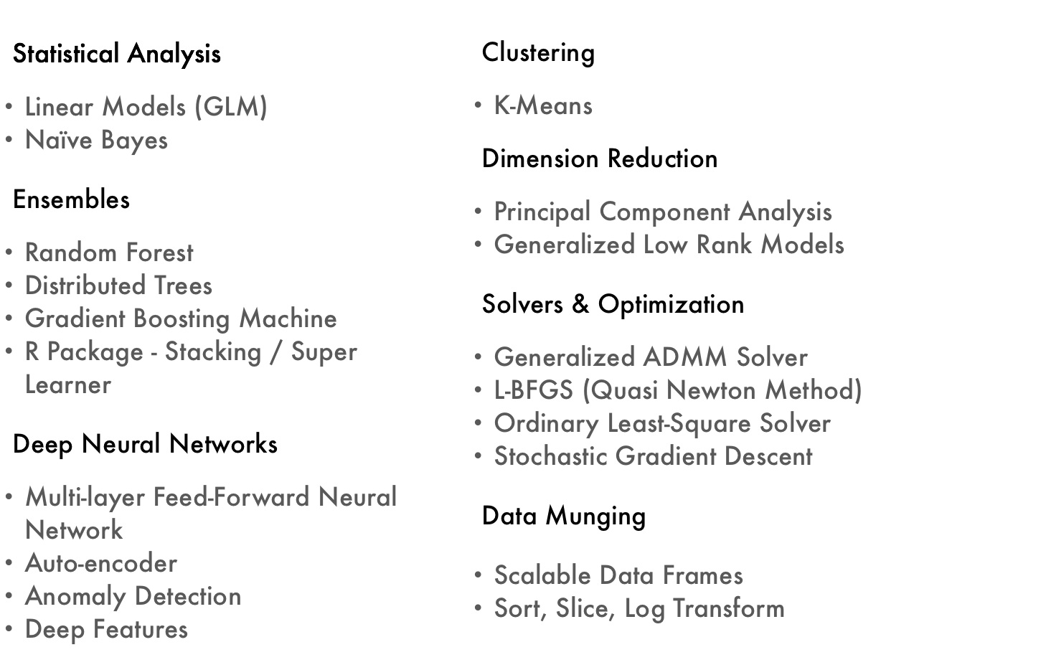
Current Algorithm Overview
Joe’s Strata Hadoop
London Talk
bit.ly/joe_h2o_talk4
Web & R
Demos
Joe’s LondonR Talk
bit.ly/joe_h2o_talk3

Slide 10
H2O Demos

Slide 11
H2O Demos
Demo 1 – Flow (Web) Interface
Public dataset
Import data
Explore data
Build & evaluate models
Make predictions
Demo 2 – R Interface
Same process using R script

Slide 12

Public Dataset – Wine Quality
Photo credit: 28.media.tumblr.com

Slide 13
Public Dataset – Wine Quality
11 Features
Characteristics of wine
Acidity, Sugar, pH ... etc.
1 Output
Quality (0 – 10)
Classification / Regression
4898 Records
White wine
UCI Machine Learning Repository
http://archive.ics.uci.edu/ml/datasets/Wine+Quality
CSV
http://archive.ics.uci.edu/ml/machine-learning-databases/wine-quality/winequality-white.csv

Slide 14
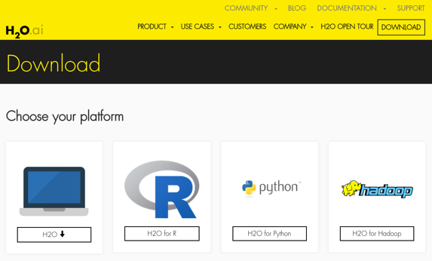
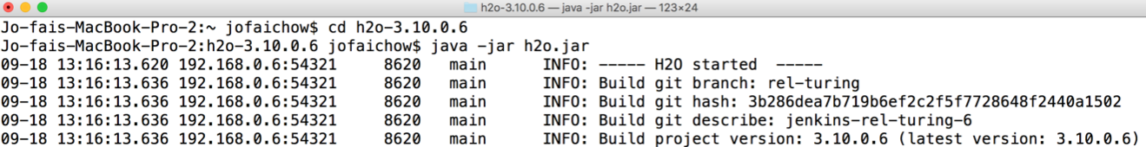
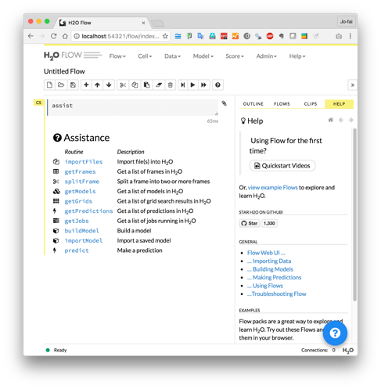
H2O Flow (Web Interface) Demo
Download and unzip jar from www.h2o.ai
In terminal:
java -jar h2o.jar
Web browser:
localhost:54321

Slide 15
H2O Web Interface – Live Demo
For online audience
Go to <this URL>
Follow step-by-step screenshots

Slide 16
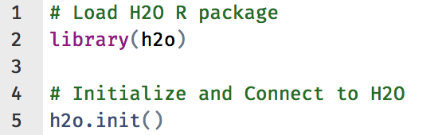
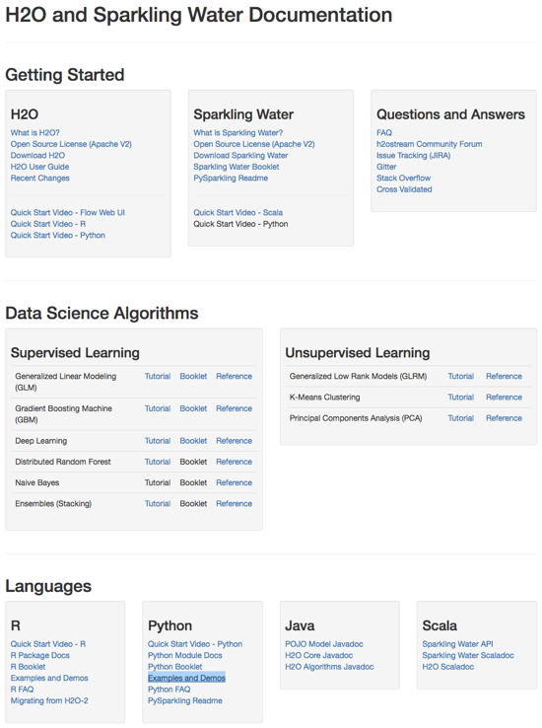
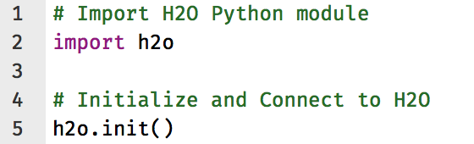
H2O Interfaces – R, Python & Others
R
Python
Resources - docs.h2o.ai

Slide 17
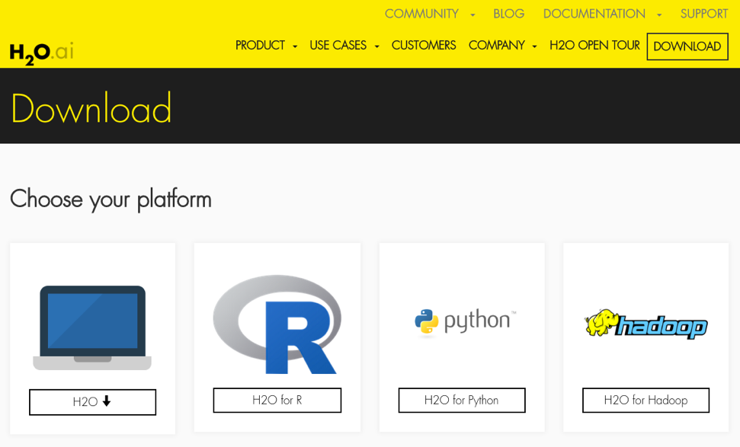
H2O R Package Demo
Install from CRAN
install.packages(“h2o”)
Install latest stable
Recommended method
See instructions on webpage

Slide 18
H2O R Interface – Live Demo
For online audience
Go to <this URL>
Follow step-by-step screenshots

Slide 19
More Advanced Topics
Hyperparameters tuning
Model stacking
Export Plain Old Java Objects
REST API
Resources:
<T.B.C.>

Slide 20
Why H2O?

Slide 21
H2O Community
T.B.C.
T.B.C.

Slide 22
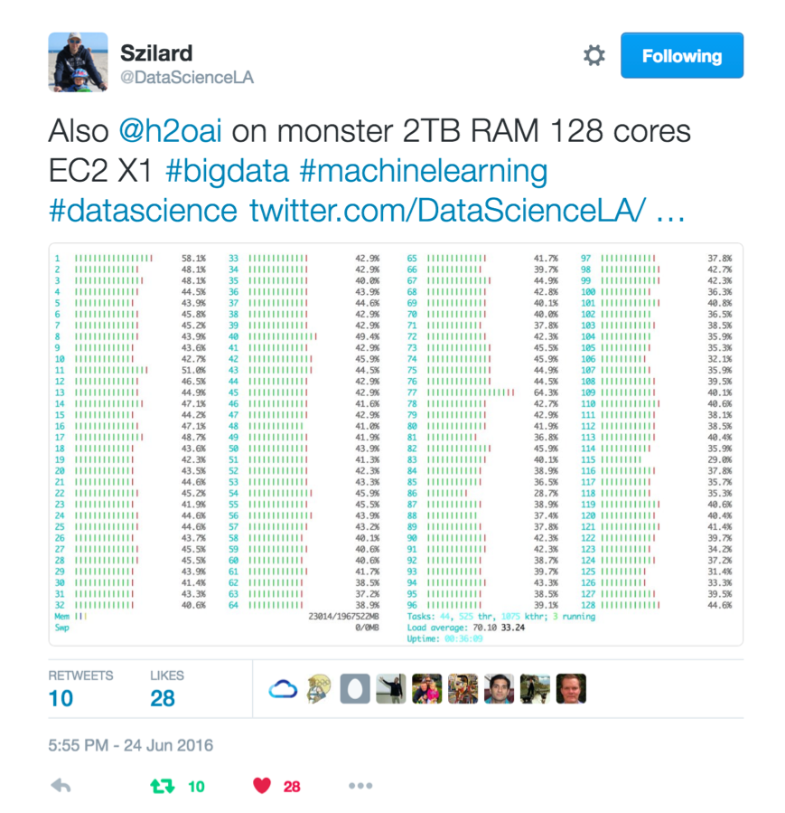
Szilard Pafka – ‎Chief Data Scientist at Epoch
Budapest DS Meetup
Szilard gave a talk
Intro to ML with H2O
User perspective
Link (video)
Link (Slides)

Slide 23
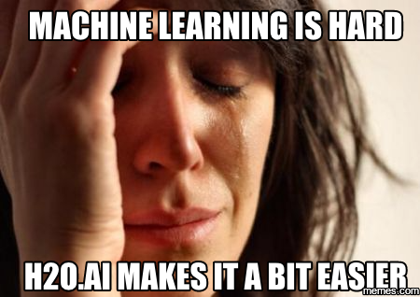
Szilard Pafka – Why H2O?
Szilard’s Summary Slide

Slide 24
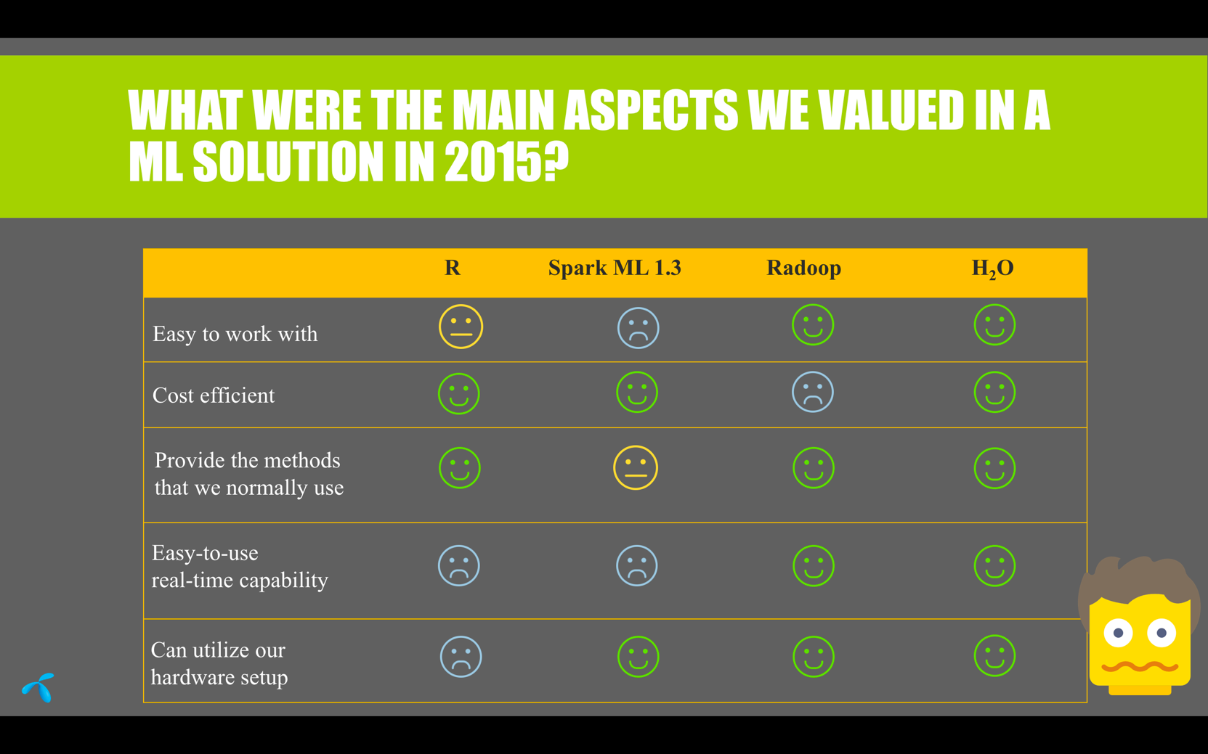
Telenor – Why H2O?

Slide 25
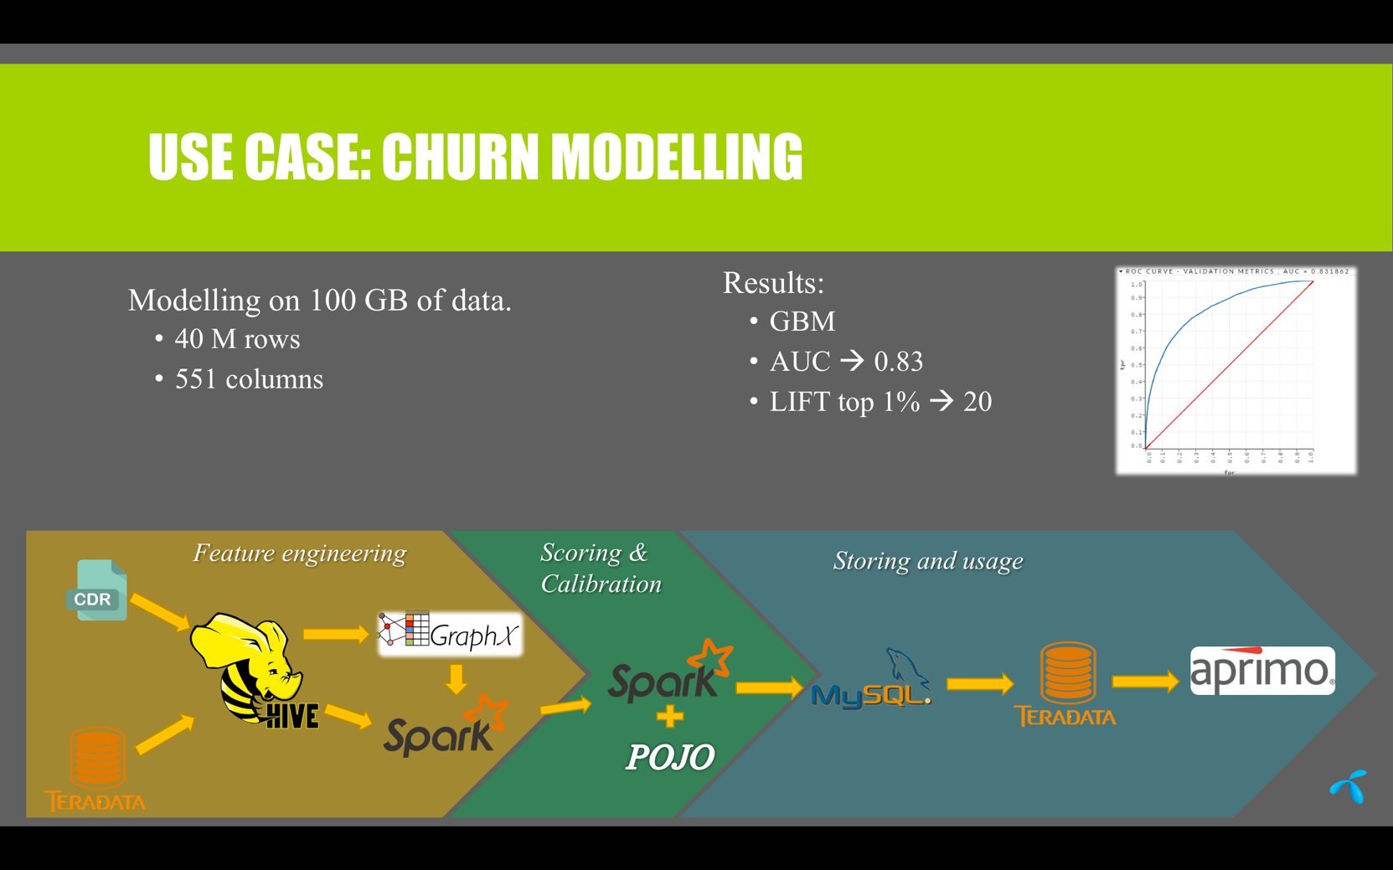
Telenor – Use Case

Slide 26
H2O Case Studies
T.B.C.
T.B.C.

Slide 27
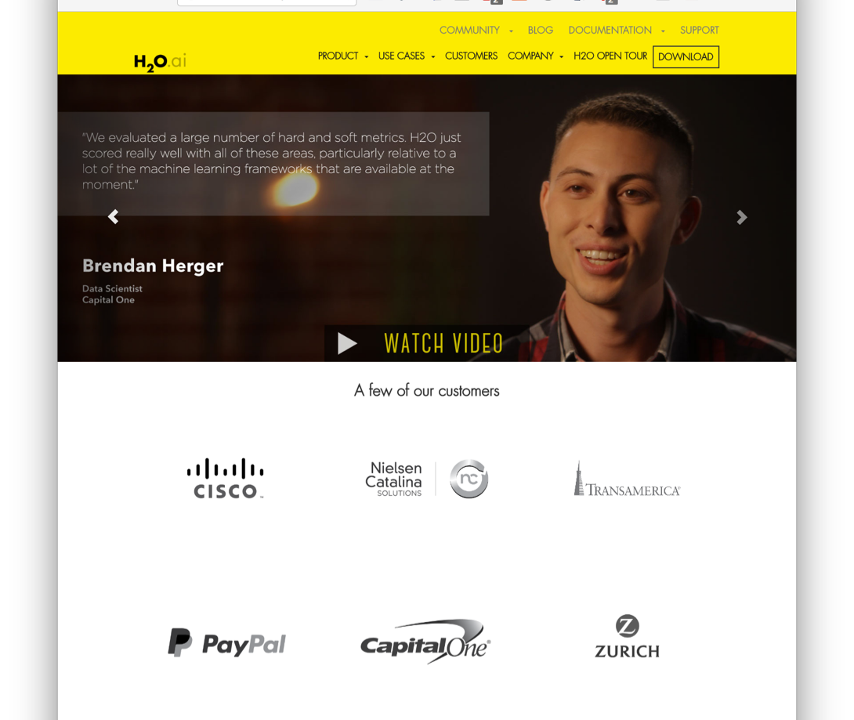
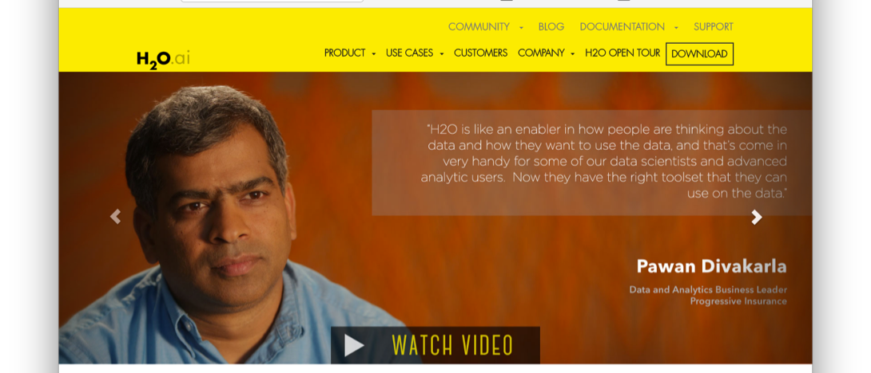
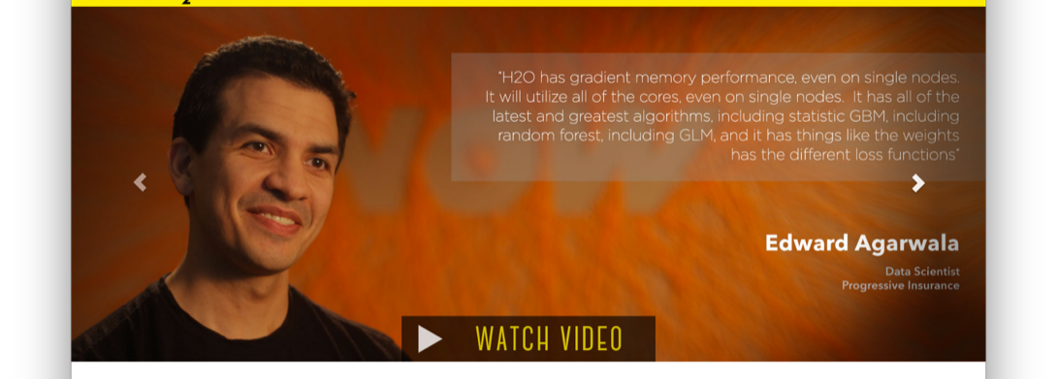
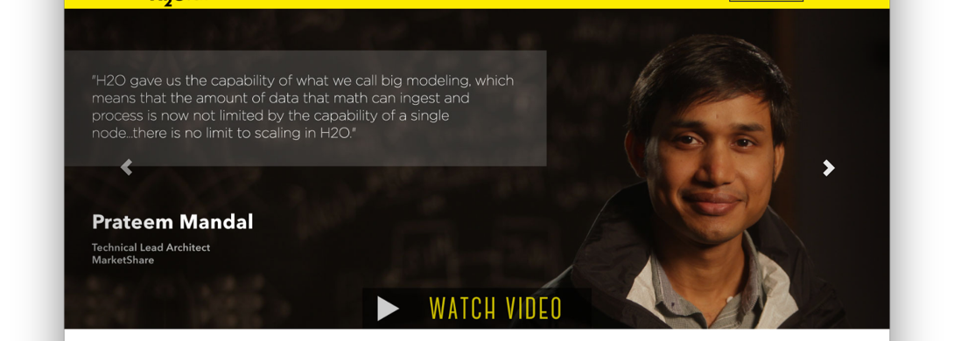
H2O Customers
Check out the videos - www.h2o.ai

Slide 28
What’s Next?

Slide 29
Recap – H2O’s Mission
Szilard’s Summary Slide

Slide 30
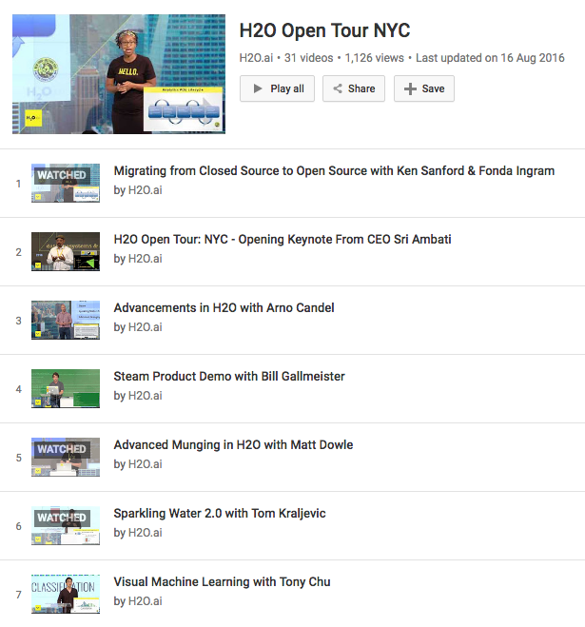
H2O is Evolving
Advanced data munging
Visual ML
Deep Water
H2O + TensorFlow, mxnet, Theano, Caffe …
GPU
Steam
User-friendly and advanced data science platform
YouTube Playlist

Slide 31
Thanks!
Paris ML Meetup
Jiqiong (Ji) Qiu
Franck Bardol
Igor Carron
Murex
Slides & Code
bit.ly/h2o_paris_1
Contact
joe@h2o.ai
@matlabulous
github.com/woobe

